Slide 1
Year 4 Class Teacher
Miss G Dromey
Thank you for your continued support
Religious Education
Our RE topic this half term is Jesus the Teacher.
We will learn about Mary and Joseph taking Jesus to the Temple. We will reflect on what this means for us.
We will know that Jesus was born a Jew. We will know about the baptism of Jesus. We will reflect on what Jesus’ baptism means for us.
We will reflect on how Mary and Joseph found Jesus in the Temple.
We will know that Jesus called people to follow him. That Jesus travelled around teaching people. We will reflect on the meaning of the parables.
How to help at home: Read different parables for example, “Parable of the Sower” - Matthew 13:3-8.
“Parable of the Weeds” - Matthew 13:24-30.
“Parable of the Mustard Seed” - Matthew 13:31-32.

Slide 2
English
Writing: Focus text (Fiction): War Game by Michael Foreman
Creating an historical setting
We will explore an extract from an historical story, recognise that in an historical setting, it’s important to make the details let the setting come alive, use brief paragraph summaries to see how the story shape is developing, recognise that details can be given in expanded noun phrases and consider different ways of beginning, sentences, including fronted adverbials, plan, edit, draft and improve a story with an historical setting.
Writing: Focus text (Non-fiction): What’s the Point?
Writing an explanatory text
We will read explanations about why they have to do certain things at school, explore the structure and organisation of the text, including the use of headings and paragraphs, identify cause and effect conjunctions usually associated with explanations, develop understanding of pronouns for cohesion, plan, draft, edit and improve an explanatory text about the ways things happen in school.
Spellings: review Autumn term spellings, Year 3/4 word list, -ous endings, improving
spelling in children’s own writing.
Reading Comprehension Text: My Secret War Diary by Flossie Albright, by Marcia Williams (inference)
The Amazing Story of Adolphus Tips, by Michael Morpurgo (inference)
The Secret World of Polly Flint, by Helen Cresswell (inference)
Heatwave Raises Lost ‘Atlantis’ Village from Its Watery Grave by Daily Mail (Mixed Skills)
Threats to African Elephants, by World Wide Fund for Nature (WWF) (retrieval)
The Great Elephant Chase, by Gillian Cross (inference)
How to help at home: Read with your child every night and sign their diary. Encourage your child to write their spelling homework in a sentence.
Maths
In Maths, this half term, we will be exploring Multiplication and Division,
11 and 12 times-table, multiplying 3 numbers, factor pairs, efficient multiplication with written methods. We will multiply 2-digits by 1-digit, then divide 2-digits by 1-digit.
The we will move on to Length and Perimeter to explore equivalent length in m, mm, & cm, kilometres adding and subtracting lengths then step into perimeter.
To end the half term we will explore Fractions. What is unit and non-unit fractions Count in tenths, equivalent fractions, fractions greater than 1, counting in fractions then adding 2 or more fractions.
How to help at home: Please encourage your child to practice their Times Tables. Can your practice drawing different shapes and measuring the area? Can they do this on the floor in their bedroom or outside?

Slide 3
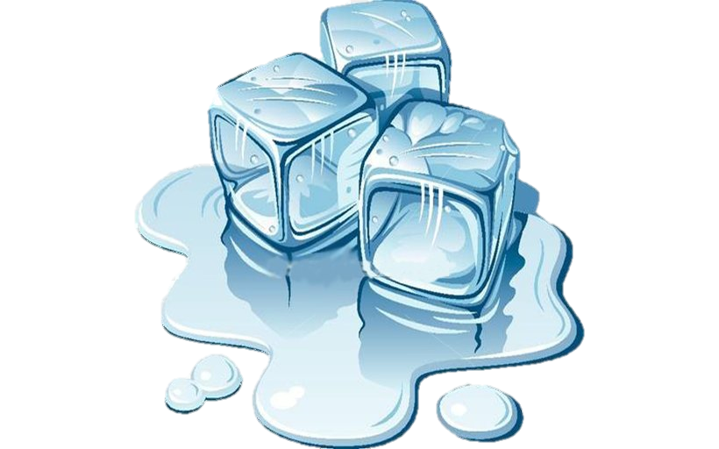
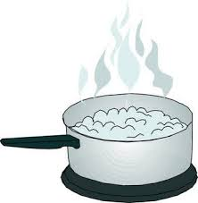
Science
Our Science topic for this half term is Looking at states.
Children will learn about states of matter. We will compare and group materials together, according to whether they are solids, liquids or gases.
We will observe that some materials change state when heated or cooled, and we will identify the part played by evaporation and condensation in the water cycle.
Geography
Our Geography topic for this half term is RIVERS AND THE WATER CYCLE.
This unit focuses on rivers and introduces the water cycle as the key concept including water flowing downhill. We will explore mountains as the source of many rivers. It looks at how people interact with rivers as well as their geographical features. We will study one of the UK’s major rivers, the River Thames.
How to help at home: Encourage your child to use river vocabulary and explore the meaning of what is a stream? Where can the estuary be found? How does steeper ground effect the current in a river?
How to help at home: Children could make a water cycle model and research labels to add to the model.
PE
Physical Education for Year 4 includes our weekly swimming lesson on a Friday afternoon & Dance.
Our Dance Water Unit will allow us to explore a range of different dance techniques, with the aim of producing an interesting and varied dance phrase that represents the water cycle.
Music
This half term our unit is called, Stop! Building on previous learning, all the learning is focused around one song: Stop! - a rap/song about bullying. Children will learn about the interrelated dimensions of music through games, singing and composing.
How to help at home: can you listen to other songs with a meaning?

Slide 4
Art
In Art this term we will be Exploring Still Life.
Key Concepts include:
That when artists make work in response to static objects around them it is called still life.
That still life has been a genre for many hundreds of years, and is it still relevant today.
That when artists work with still life, they bring their own comments and meaning to the objects they portray.
French
This half term we will begin by looking at Epiphany before looking at nouns for family members and learning the different names for parts of the face.
How to help at home: Can you practice ‘Heads, shoulders, knees and toes’ in French?
How to help at home: explore the life and art of Paul Cézanne, a French artist and Post-Impressionist painter
Computing
In computing, we will be creating a video.
Pupils will create their own videos and apply special effects to them. Then will also learn how photos/videos can be edited online for advertisement .
PSHE/RSE
This half term we will explore Emotional Well Being.
We will look some behaviour is wrong, unacceptable, unhealthy and risky; Thankfulness builds resilience against feelings of envy, inadequacy and insecurity, and against pressure from peers and the media
How to help at home: make a video to show off your skills. Cooking, baking, or make something amazing.
How to help at home: staying safe online. Taking mindfulness breaks.
Books to Share at Home

