Slide 1
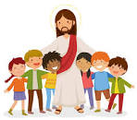
Reception
Curriculum Plan
Spring Term One
To Be The Best That We Can Be
Reception Class Teacher
Mrs C Knox
Thank you for your continued support
Religious Education
Reception’s RE topic is ‘Getting to know Jesus’.
The children will be getting to know Jesus. Throughout the topic, the children will be given opportunities to become aware that Jesus has a great love for each one of us and will think of ways in which we can show our love for Jesus.
They will hear that Jesus cured people who were sick and think of ways we can show our love for sick people.
How to help at home: Encourage children to ask Jesus for help for themselves and others. Talk about how we can show love for Jesus.
WEBSITE: www.st-josephs.manchester.sch.uk
TWITTER: @St_Josephs_RC
Tel No: 0161 224 5347

Slide 2
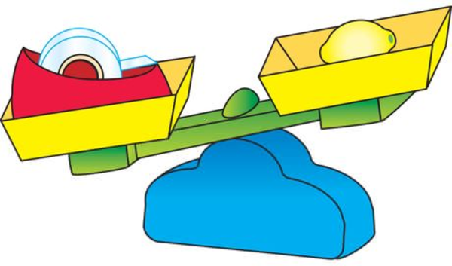
English
This half term, children will look at stories and poems from different cultures such as Handa’s Surprise and The Runaway Chapatti. We will retell the stories and then change elements of them to create different versions. ​
In phonics, children will be introduced to the Read Write Inc. sounds and actions for the remaining Set 1 letters: y, w, th, z, ch, qu, x, ng and nk. They will be taught how to remember a whole sentence in their heads before writing it down using their newly acquired phonic knowledge.
How to help at home: Continue to read a range of books with your child. Explain any new words and encourage them to use them, where possible. Get your child involved in any writing activity, for example, shopping lists, greetings cards etc.
Maths
Children will be introduced to zero and the idea that it represents nothing.
They will represent numbers 6-8 in different ways and learn to count out a required number from a larger group. They will begin to combine 2 groups to find out how many altogether.
Children will investigate weight and capacity. They will estimate which items will be heaviest or lightest and use balance scales to check their estimation and will explore capacity using different materials such as water, sand rice and beads. They will compare height and length, measuring objects with blocks and cubes.
How to help at home: Compare the height, length and weight of different objects at home. Encourage children to count objects and to combine two small groups of objects to find a total. (For example, I have 2 sweets, you have 3 sweets. How many altogether?)

Slide 3
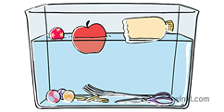
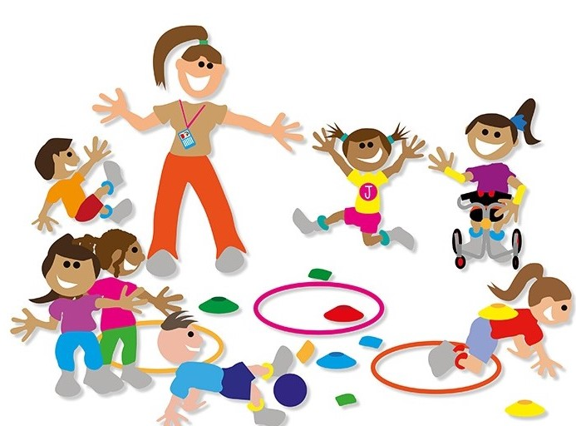
Science
Our science topic for this half term is ‘Floating and Sinking’.
Children will perform a variety of experiments to ascertain what makes an object sink or float.
We will then use this information to build a boat.
Geography
Our history topic for this half term is ‘Manchester and the UK’. Children will learn about the situation of Manchester in the UK and in the world.
We will take a trip into Manchester and look at the main landmarks. We will talk about how Manchester has changed over the years. We will look at maps of the local area and draw our own. We will talk about housing and jobs in the area and ways children would like to improve their surroundings.
How to help at home: Ask children to predict whether an object is likely to float or sink. Put it in water to test their prediction. This is a fun activity for bath times or walks near water.
How to help at home: Point out local landmarks and different types of houses on your journeys to and from school.
PE
Real Gym Unit 4
In gymnastics, children will learn, develop and apply flight and rotation on the floor and apparatus through skill development, thematic warm-ups and games.
Music
This half term, we will be listening to songs such as ‘Happy and you know it’ and ‘Heads, shoulders, knees and toes’. We will be exploring the pulse and pitch and copying some of the rhythms from the songs. We will use glockenspiels to make melodic patterns with two notes.
How to help at home: Listen to a variety of music genres. Tap along to the pulse or beat and try to copy some of the rhythms.

Slide 4
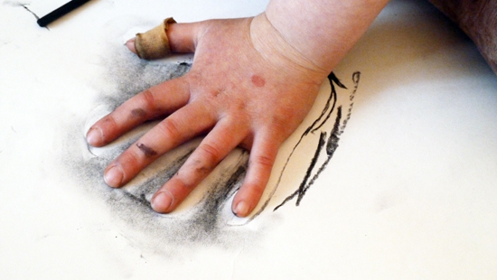
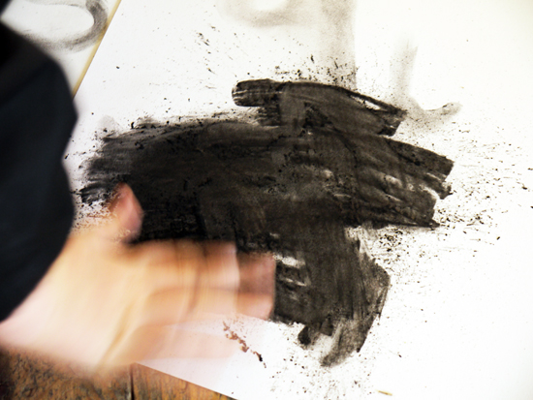
Art
In Art, we will learn about the origins of drawing before using charcoal to draw like cavemen. We will learn how to make thick and thin lines, smudge and make a palette of loose charcoal that we can make marks with. We will then learn how to make a negative space image of our handprints.
How to help at home: Encourage large scale mark making with a range of media such as chalk, mud, coal etc.
PHSE
This half term, we will consider likes, dislikes and interests that we have in common. We will then talk about the many feelings we experience. Using familiar texts, we will explore how to deal with difficult emotions such as sadness, anxiety and anger.
We will talk about the things we do, when we are happy.
Computing
Look At What I Can Do.
In computing, children will talk about different kinds of information such as pictures, videos, text and sound. They will use a mouse and a touch screen to move objects on a screen.
How to help at home: Point out, and embrace, similarities and differences within your family and friendship groups.
How to help at home: Encourage children to develop their mouse control skills on a PC or laptop. Look at free colouring in activities on the internet.
Books to Share at Home

