Slide 1
Year 2 Class Teacher
Miss N Seabright
Thank you for your continued support
Religious Education
RE topic this half term - The Good News
In this unit the children will learn about the Holy family and reflect on Jesus being you like us.
They will find out how Jesus chose some helpers and think about what we can learn from Simon and Peter.
The children will learn about the story of the Ten Lepers and reflect upon why it is important to say thank you and about Jesus performing a miracle to feed the hungry crowd. On reflection we will think about ways that we can help others.
Finally we will learn about the man Jesus cured who was paralysed and reflect on the great love Jesus has for all who are sick.
How to help at home: Using a children’s bible share other stories where Jesus performed miracles.

Slide 2
English
Writing: Focus text (Fiction): The Lighthouse Keeper’s Lunch by Rhonda Armitage. We will explore: verbs, adverbs, co-ordinating conjunctions and subordinating conjunctions, compound words and we the use of a range of punctuation. Within this unit the children will identify how each stage of the story is linked to the central problem and what they can learn and infer about the characters from the text.
Writing: Focus text (Non-fiction): In this unit we will read a set of instructions for How to Make a Pompom.
We will explore: How to follow and evaluate a set of instructions and gain an understanding of the structure, layout and sequence, imperative (command verbs) and how adjectives are used in instructions. ​
Spellings: ​In spelling our focus will be on the Year 2 common exception words along with words ending in ‘le, el and al’
Reading Comprehension Text:
The Jolly Christmas Postman (Fiction) – Word Meaning
The Life of Roald Dahl: A Marvellous Adventure (Non-Fiction) – Mixed Skills
George’s Marvellous Medicine (Fiction) – Retrieval
How to Build a Gingerbread House (Non-Fiction)- Retrieval
Hansel and Gretel (Fiction) – Retrieval
Hansel and Gretel (Fiction) - Inference
How to help at home: Don’t forget to read and share stories with your child as well as getting them to read to you.
Maths
In Maths, this half term, we will be focusing on Money along with Multiplication and Division. Within these units we will look at counting money (notes and coins), comparing money, finding the difference and finding change. We will cover making equal groups, adding equal groups and making arrays. We will regularly do arithmetic and word problems discussing methods and model how to approach the questions.
How to help at home: How about role playing shops using real money Can your child add amounts and select the correct coins for the items they buy?

Slide 3
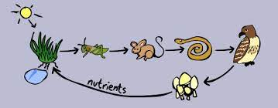
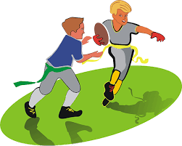
Science
Our Science topic this half term is Our Local Environment. This topic brings together the study of living things, habitats and growing plants and is strongly focussed on outdoor learning and investigations.
Geography
Our Geography unit this half term is Food Journeys. This unit links the everyday experience of buying and eating food within the UK with the children’s growing geographical understanding of the world. As with many units in KS1, there is a strong element of local area study. This will begin to show the class the connections between what we buy, where it comes from locally and how it might be able to be sourced from the UK (and beyond).
How to help at home: Go on a walk with your child to the local park. Can they find things that are living, dead, and things that have never been alive?
How to help at home: Talk about what cereal crops are made into to help your child understand how the raw product started out and the process it goes through to be changed into something else.
PE
Real Dance Unit 1
In this unit, the children will learn and develop shapes and circles and create sequences of movement with these through partnering and artistry.
PE is Wednesday and Friday
Please ensure that your child has their P.E kit in school.
Music
This half term, in Music the children will learn a Rock song called I Wanna Play In A Band by Joanna Mangona. In this unit the children will learn about singing and playing together in ensemble. As well as learning to sing, play, improvise and compose with this song, children will listen and appraise class Rock Songs.
How to help at home: Encourage you child to listen to a variety of classic Rock songs. What instruments can they hear?

Slide 4
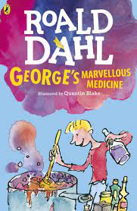
Art
In Art and Design this half term, the focus will be Expressive painting. We will explore how painters sometimes use paint in an expressive and gestural way. We will also explore colour mixing and experimental mark making to create abstract still life.
How to help at home: Experiment making different marks using a range of tools.
PHSE
This half term, children will meet presenters Jayden and Josie and fictional character Super Susie. They will help children to understand and articulate their own changing feelings and how other people’s feelings might differ from theirs. Children will learn how they can manage their feelings and about the consequences of their actions.
Computing
In computing this half term the children will be looking at presenting data. In this unit the children will create a presentation of their class topic using the app Shadow Puppet EDU.
How to help at home: Talk to your child about different words they might use to describe feelings.
How to help at home: Can the children create a presentation at home to show what they have been learning in school
Books to Share at Home

