Slide 1
Year 3 Class Teacher
Miss A Nuttall
Thank you for your continued support
Religious Education
Sacrament of Reconciliation
The children will understand what it means to make wrong choices.
They will reflect on how wrong choices affects us and other people.
They will know how Jesus called people to turn away from sin.
Think about why this is important.
The children will understand that God always loves us. They will think of how important this love is for us. The children will know what the Sacrament of Reconciliation means.
They will reflect on God’s love and forgiveness. The children will know what happens during the Sacrament of Reconciliation..
They will think about what this Sacrament does for us.
How to help at home: Encourage your child to make the right choices.
Discuss the importance of saying sorry when you make the wrong choices.
Talk about how our behaviour can affect others.

Slide 2
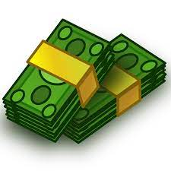
English
Writing: Focus Text (Non-Fiction): How Do Your Senses Work? What we will explore: an explanatory text, paragraph structure, second and third person, technical and subject specific vocabulary: plan, draft, edit and improve an explanatory text .
Writing: Focus text (Fiction): Frankie vs. the Pirate Pillagers text by Frank Lampard. We will explore: a fantasy story, conjunctions and adverbs support the use of paragraphs, noun phrases, adjectives, dialogue, ​adverbs, preposition, punctuation; plan, draft, edit and improve a continuation of the story, using information and description from the model text.
Spellings: review Autumn term spellings, Year 3/4 word list, prefix re -, super-
Reading Comprehension Text:
The Selfish Giant (Fiction) - Progress Check
The Ice Palace (Fiction) – Inference
A House Of Snow and Ice (Non-Fiction)- Retrieval
The Heavenly River (Chinese Myths and Legends) - Inference
New Year Celebrations (Non-Fiction) – Comparison
Night Comes Too Soon (Poetry) – Word Meaning
How to help at home:Look for conjunctions and adverbs in your child’s reading book.
Can your child use these words in a piece of writing of their own?
Maths
In Maths this half term, we will be completing our work on multiplication and division, especially dividing 100 into 2,4,5 and 10 equal parts, dividing with remainders and dividing 2-digits by 1-digit.
We will then move on to learning about money, focusing on counting in pounds and pence, adding and subtracting money, giving change and converting money from pounds to pence and from pence to pounds.
We will use play money to recreate real life situations that involve money.
How to help at home: Please encourage your child to practice their timestables to secure their table facts. Allowing your child to use money when you are shopping will also help to contextualise their learning.

Slide 3
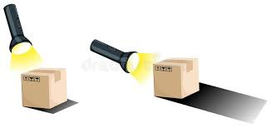
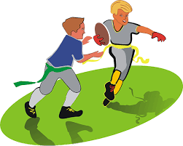
Science
Our Science topic for this half term is Light and Shadows
Children work scientifically on a variety of quick challenges and longer tasks to learn about the wonders of light, including reflections and shadows.
Geography
Our Geography topic for this half term is Our World.
In this unit, they will begin to understand the Earth better as a sphere, learning to rotate it mentally in 3-D. They will explore its representation in 2-D maps, and learn about the imaginary lines used (Equator, latitude, longitude, tropics and the International Date Line) to pinpoint global locations.
How to help at home: Ask your child about the scientific language they have learnt at school.
Explore changing shadows at home by creating shadow puppets.
How to help at home: Use Google Earth to help you draw a map of your local area.
PE
PE is taught by City in The Community.
This half term our focus will be Gymnastics. We will develop our coordination, strength and flexibility.
PE is taught on Mondays
Please ensure that your child has their PE kit in school.
Music
This half term, our learning in Music is linked to ‘Three Little Birds’ by Bob Marley. As well as singing and accompanying the song with musical instruments, we will explore pulse, rhythm and pitch.. In addition, we will listen to, and evaluate, the work of other reggae artists.
How to help at home: Listen to Reggae music with your child. Discuss the origins of Reggae music in Jamaica in the 1960s and how its popularity spread to the rest of the world.

Slide 4
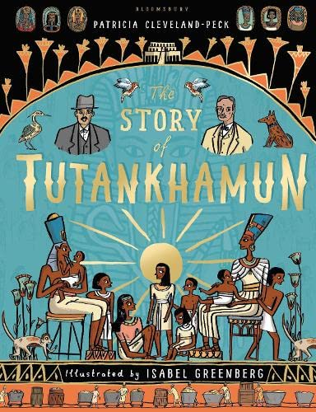
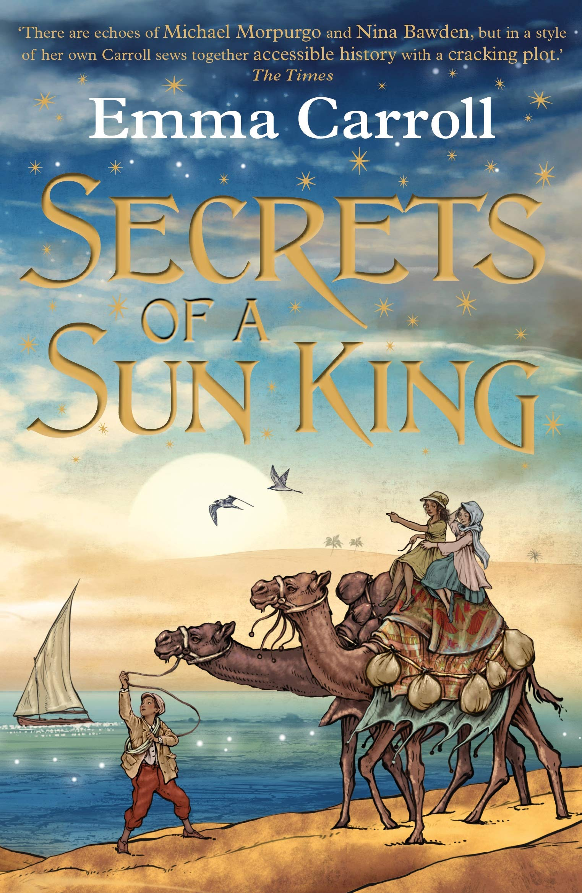
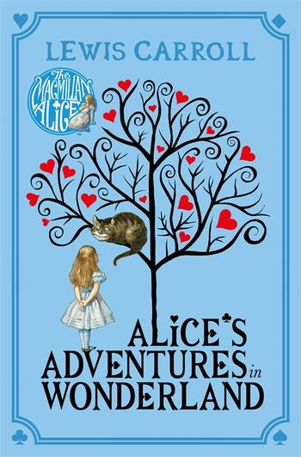
Art
In Art children use close looking to explore artwork. Children then explore how they can use shape and colour to simplify elements, inspired by the Cut-outs of Henri Matisse. Using collage, pupils create meaningful compositions.
French
This half term, we will be expanding our French vocabulary. In particular, we will be focusing on naming and describing animals and pets.
How to help at home: play and explore by cutting out shapes and creating interesting artwork based on the work of an artist of your choice.
How to help at home: Can you draw animals and label them with their names in French?
PHSE/RSE
This half term we will be focussing on keeping safe. In this unit we will learning about the dangers of second had smoke, the importance of recognising dangers and how to respond in an emergency. Children will learn in greater depth about the effects of drugs, alcohol and tobacco and how to make good choices concerning these as they get older. Also, keeping safe online The final session of the module explores what to do in emergency situations.
Computing
Creating a Programmable World.
Pupils will create a Programmable world using Kodu.
How to help at home: Talk about recognising dangers whilst walking in the local area.
Ask your child to recount what they have learnt about responding in an emergency.
How to help at home: Download Kodu (free) and ask your child to show you what they have learnt in school.
Books to Share at Home

