Slide 1

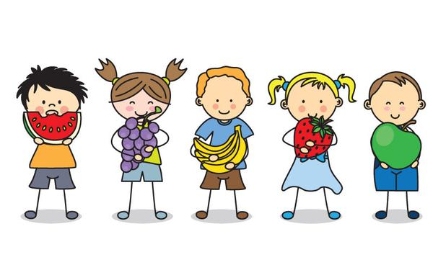
Welcome to
Reception
St Joseph’s RC Primary School
Class Teacher: Mrs Narciso

Slide 2
Welcome
Dear Parents/Carers,
We have had a lovely first week in Reception. The children are truly delightful and have settled quickly and effortlessly into the new routines and learning.
Water Bottles
In order to stay fully hydrated, children are invited to bring in a named water bottle (filled with still water only).

Slide 3
What We Are Learning
Our topic this half term is ‘People who help us’.
We are hoping to have visits from members of the community to talk to us about their jobs including a builder, police and fire officers. If you, or someone you know, has a job that they could talk to the class about, please let us know. We would love to hear from you.
More details of our learning this half term can be found on the class website under ‘Year Group Curriculum Plans’.

Slide 4
Reading
Learning to read is a vital part of Reception education. Your child will be given a reading scheme book and a reading for pleasure book each week. Please read these books with your child for a minimum of 10 minutes each day, sign the Reading Record Book and send the books in with them every day so that we can hear them read in school.

Slide 5
School Times & Homework
Children will be dismissed from the Reception gate at the side of school at 3.10pm. Please indicate to staff that you have arrived and we will send your child over to you. If someone different is picking your child up, please call school in advance to let us know.
Homework will be sent home on Wednesdays to be returned on Mondays. Work not completed at home, will be done at playtimes so that children don’t fall behind.

Slide 6
Uniform
Children must be wearing their complete uniform which consists of:
navy school jumper/cardigan,
grey dress/ skirt/trousers,
school tie,
pale blue shirt (not polo shirt),
black shoes (not trainers),
grey socks/tights.
All hair bobbles/bows should be in school uniform colours.
As shirts are to be worn tucked in at all times, please teach your child how to tuck them in.
To encourage independence, please ensure that your child is able to fasten their shoes themselves.
On health and safety grounds, the only jewellery children are allowed to wear are stud earrings.
As much of our learning takes place outdoors, in all sorts of weathers, children will need a complete change of clothes (including underwear) and a named pair of wellington boots to stay in school.
Children won’t need their PE kit until January. Please ensure that all items are clearly labelled with your child’s name.

Slide 7
Thankyou
Most communication will be done through Dojo messaging.
However, if you would like to speak to any of us, we can make an appointment to see you before or after school.
We look forward to meeting you.
Mrs Narciso, Miss Saini

