Slide 1

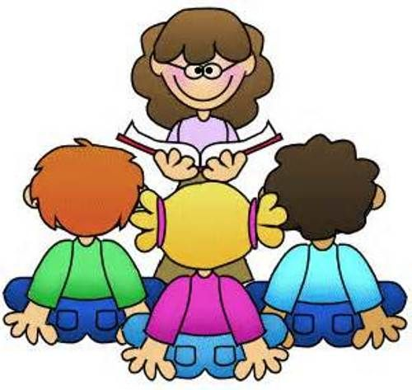
Welcome to
Year 4
St Joseph’s RC Primary School
Class Teacher: Miss Lowrie

Slide 2
Welcome
Dear Parents/Carers,
Welcome to Year 4! This is just a short message to introduce myself and some of the routines for your child this year. My name is Miss Dromey and I am really looking forward to working with you and your children this year. More than ever this is a very important year for your child. I hope you will continue to support your child as they progress through this year.

Slide 3
What We Are Learning
Religious Education
Autumn Spring Summer
The Bible Jesus, the Teacher The Early Christians
Trust in God Jesus the Saviour The Church.
Science
In Science we will be exploring 5 units over the Year.
What’s the Sound?
Living Things
Looking of States
Teeth and Eating
Power it up

Slide 4
What We Are Learning
History/Geography
Each term we will explore either a History or Geography unit.
Term | Geography | History
Autumn 1 | The Americas
Autumn 2 |  | Ancient Egypt
Spring 1 | Rivers and the Water Cycle
Spring 2 |  | Ancient Romans
Summer 1 | Earthquakes and Volcanoes
Summer 2 |  | Crime and Punishment

Slide 5
Times Tables Test
In June/July next year, your child will take part in the ‘Times Table Test’. Your child will have 25 questions to read, based on multiplication facts from their 2s to their 12s times tables. A 6 second time limit placed on each question. The test will last around five minutes and a ‘Pass or Fail’ mark will be given at a later date.
At home, you can practice on a range of online games to help build confidence and
knowledge in your child throughout the year.
https://www.timestables.co.uk/
https://www.mathsisfun.com/tables.html
https://www.topmarks.co.uk/maths-games/7-11-years/times-tables

Slide 6
Reading
Every child will have their reading checked daily; therefore, it is very important that your child has their reading book in school everyday. Your child needs to read 15 minutes each night and their reading record, signed. Books are now changed on a Monday and Friday.
Re-reading books is an important part of learning, particularly when trying to understand a book more confidently and consolidate a good knowledge of a text. Your child may sometimes bring home a book they have already read to read again.
This does not mean they are struggling or being ‘held back’, it is an opportunity to revisit a text and become more familiar with it and develop confidence.

Slide 7
Homework
Homework is given on Wednesday and it consists of Spellings/handwriting, Times tables, a comprehension.
The Homework book should be returned by Monday morning. I hope you will support them in this as much possible, as help and support at home has a greater impact.

Slide 8
Uniform
Children must be wearing their complete uniform which consists of:
navy school jumper/cardigan,
grey dress/ skirt/trousers,
school tie,
pale blue shirt (not polo shirt),
black shoes (not trainers),
grey socks/tights.
navy blue headscarf (if required)
all hair bobbles/bows should be in school uniform colours.
As shirts are to be worn tucked in at all times, please teach your child how to tuck them in.
To encourage independence, please ensure that your child is able to fasten their shoes themselves.
On health and safety grounds, the only jewellery children are allowed to wear are stud earrings.
As much of our learning takes place outdoors, in all sorts of weathers, children will need a complete change of clothes (including underwear) and a named pair of wellington boots to stay in school.

Slide 9
P.E. & Swimming
The children will have P.E. on a Monday. The children are to keep their kit in school and take it home at the end of the half term to be washed; this ensures that they can do P.E. and do it safely. The kit should include a pair of navy shorts, a white t-shirt and a pair of trainers (navy or black leggings may be worn if required as we are doing PE outside), which all needs to be labelled.
For health and safety reasons children are not allowed to wear jewellery during a P.E. lesson.
We will be going swimming every Friday. No earrings to be wore while swimming, even studs.

Slide 10
Thankyou
Thank you for your support.
Miss Lowrie

